Slide 1
New Mexico Crime Victims Reparation Commission

Slide 2
The Crime Victims Reparation
Commission assists victims of violent
crime with expenses incurred as a
result of their victimization.
We also administer funding to
organizations to provide victim
services statewide
Notes:
Every State and Territory has a Victim Compensation program
Began to ensure victims co-operated with LE/Criminal case and provide a financial source before restitution was paid

Slide 3
Compensation Funding
State
Federal
Inmate Wages/Restitution
Penalty Assessment(s)
Notes:
State = $700k
Federal = $600k
Inmate Wages (15%) / Restitution (court ordered) / Penalty Assessments = $1m
FY15: 1,300 claims / FY16: 2,600 claims / FY17: 3,000 claims / FY18: 3,700
AVG.: $2 mil payouts

Slide 4
Compensation
Victim of Violent Crime
New Mexico
Law Enforcement (30 days) (180)

Slide 5
Determining Eligibility
Notes:
Review police reports // law enforcement verification forms
* advocates can provide additional information to help in determining eligibility
Reductions: 75% , 50% , 25% , denial
If possible, victims/family may need to read the police reports.
Appeal process: letter to CVRC Director with new supporting documentation, independent victim advocate to review file, request to speak to Commission members

Slide 6
Reimbursement
Notes:
Review police reports // law enforcement verification forms
* advocates can provide additional information to help in determining eligibility
Reductions: 75% , 50% , 25% , denial
If possible, victims/family may need to read the police reports.
Appeal process: letter to CVRC Director with new supporting documentation, independent victim advocate to review file, request to speak to Commission members

Slide 7
Crimes Enumerated
Notes:
Review police reports // law enforcement verification forms
* advocates can provide additional information to help in determining eligibility
Reductions: 75% , 50% , 25% , denial
If possible, victims/family may need to read the police reports.
Appeal process: letter to CVRC Director with new supporting documentation, independent victim advocate to review file, request to speak to Commission members

Slide 8
Abuse or Abandonment of a child
Aggravated indecent exposure
Arson resulting in bodily injury
Aggravated assault; Aggravated battery
Assault against a household member
Battery against a household member
Criminal sexual penetration
Criminal sexual contact of a minor
Dangerous use of explosives resulting in bodily injury

Slide 9
Failure to Give Information & Render Aid
Homicide/Great Bodily Injury by vehicle
Human trafficking
Involuntary manslaughter
Kidnapping
Negligent use of a deadly weapon
Murder
Stalking
Voluntary manslaughter

Slide 10
$20,000.00

Slide 11
$30,000.00

Slide 12
Eligible Expenses
Medical
Loss of Wages
Funeral
Counseling
Pecuniary Expenses

Slide 13
Collateral Sources
Ineligible Expenses
Causal Behavior
Notes:
Ineligible expenses:
*Legal Fees
*Property loss or Damage
*Pain & Suffering
CAUSAL BEHAVIOR: Knowing/willing involvement in commission of crime // provoking incident // illegal drug use // gang related crime/activity // knowing/willing riding in vehicle operated by person under influence of alcohol/controlled substance // operating vehicle while intoxicated // failure to wear seatbelt // unjust enrichment

Slide 14
Donations
NO Funeral!

Slide 15
100%

Slide 16
65%

Slide 17
Statute Enhancements
Convicted of a felony, penalty assessments
$75.00
Convicted of a misdemeanor penalty assessments
$50.00

Slide 18
Exception to the 2 year filing limit

Slide 19
Priority Processing
Notes:
Homicide cases only // Initiated by an advocate // Financially unable to pay // Priority Processing Coversheet // CVRC compensation applications // Police report or law enforcement verification form // Funeral contract

Slide 20
Rent & Relocation
Notes:
Domestic violence // Sexual assault // Human trafficking // Homicide (if occurred in the residence)
Safety/Financial plan? ***Once in a lifetime expense****
Relocation: moving truck, storage, temporary shelter, travel, rent deposit, utility deposits
Rent: 3 months or $1,500.00 *whichever occurs first*

Slide 21
www.cvrc.state.nm.us cvrc@state.nm.us

Slide 22
CCVCNM.ORG

Slide 25
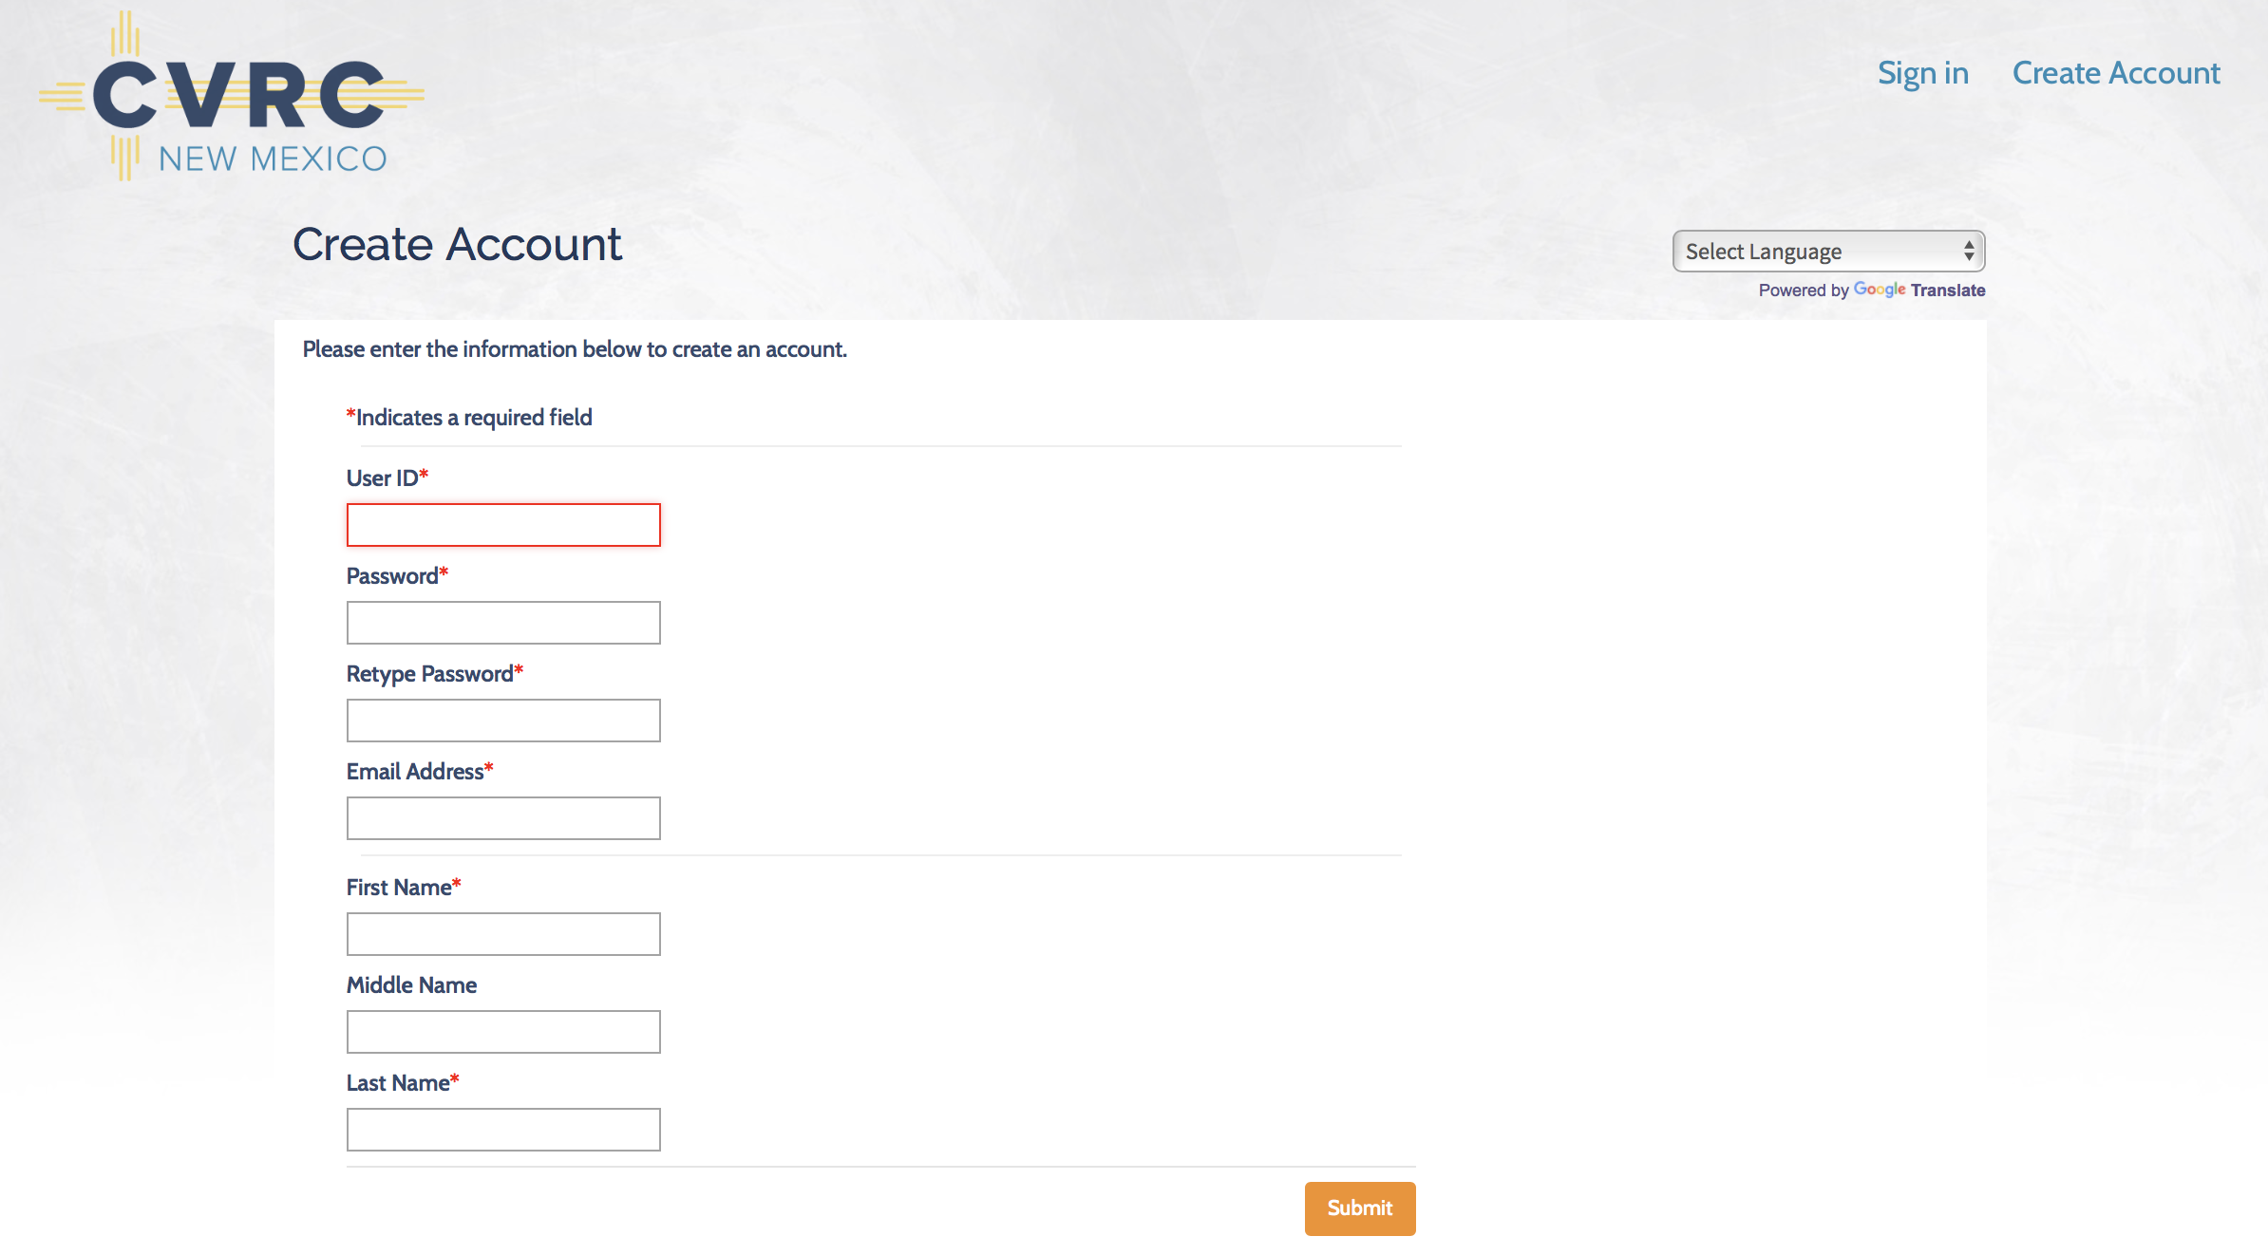

Slide 26
NMguest

Slide 36
QUESTIONS?

Slide 37
Thank you

