Slide 1
2018 New Mexico Academy for Victim Assistance
September 10-12, 2018

Slide 2
VOCA Victim Assistance Emergency Funding
WHAT: Up to $1500
WHEN: Mon-Fri, 8 a.m. – 5 p.m.
WHO: Must be advocate initiated, NOT victim
HOW: Advocate may call regional ER admin agency to discuss to see if potentially eligible
99.9% of ER funding is paid to a vendor, NOT directly to victim

Slide 3
Criteria
Immediate health & safety issues - direct result of a violent crime
Must attempt contact with 1 viable resource
Must complete ER Check Request Forms and email/fax to ER Administering Agency
May take up to 24 hours to get funding

Slide 4
Administering Agencies
Community Against Violence
Sexual Assault Services of NW NM
La Casa
El Refugio
Roberta’s Place
Assurance Home
CVRC

Slide 5
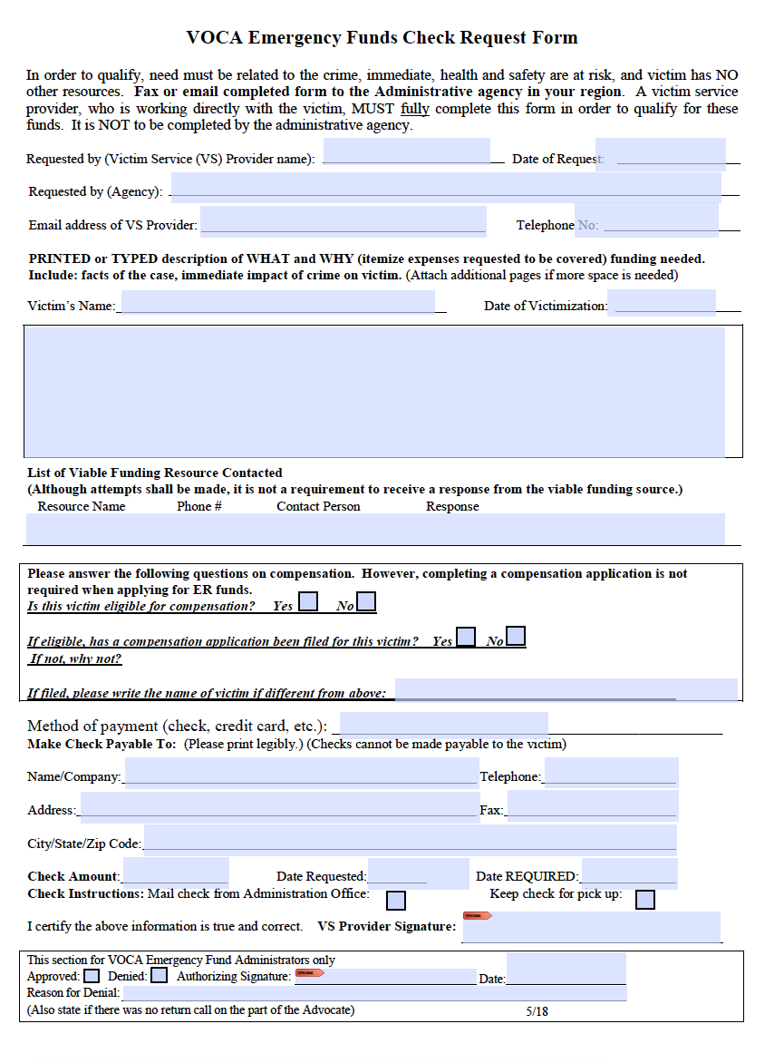

Slide 6
Allowable ER Costs
Relocation/rent - immediate safety issue
1 month rent/utilities – no arrears!
Exterior window/door/lock repair/replacement
ER counseling/some medical/some prescriptions
Eyeglasses/contacts/hearing aids (up to $700)
Mileage/per diem (transportation)

Slide 7
Allowable ER Costs (cont’d)
Crime scene clean up
Emergency civil legal
Emergency food and clothing
Emergency shelter/temporary housing/hotel

Slide 8
Not Allowable Under ER Funding
Funeral/burial expenses
Prosecution/investigation activities
Crime victim compensation expenses unless otherwise stated
Medical care unless otherwise stated
Long term housing
Expenses related to recovering lost property
Non-emergency or need not related to crime

Slide 9
Questions?

Slide 10
Emergency Funds Online Resources
On CVRC website:
List of administering agencies
Emergency funds guidelines
Emergency funds check request fillable form
This presentation

Slide 11
www.cvrc.state.nm.us cvrc@state.nm.us

Slide 12
Thank you

